Slide 1
CPSC 3720: Lecture 3: Software Planning & Process
Eileen T. Kraemer and Murali Sitaraman, Clemson
E-mails: etkraem@clemson.edu and murali@Clemson.edu
Spring 2018 version
Some of the lecture slides have benefitted from the findings of grants from the US National Science Foundation.
Notes:
Allow 15 minutes for lifecycle quiz

Slide 2
Software Lifecycle Phases
Requirements analysis
Design and specification
Implementation
Quality Assurance
Maintenance

Slide 3
Project Planning
Predictive planning
Adaptive planning

Slide 4
Project Planning
Understand initial requirements and identify significant tasks
Remember the bottom line: High quality software on time on budget
Budget: Do cost estimates
Time: Set up project milestones

Slide 5
Cost Estimation
Depends on prior project experiences and backgrounds of personnel
COCOMO (Constructive Cost Estimation Model)
Other cost estimation models

Slide 6
COCOMO
developed by Barry W. Boehm in the late 1970s
Software Engineering Economics (1981)
Looked at codes with 2K to 100K LoC
Assembly, PL/I
Waterfall model

Slide 7
COCOMO II
Also Boehm
Developed ‘95, published 2000
Includes agile development process*
Based on:
more projects
Desktop applications vs. mainframe/batch
Reuse
Off-the-shelf components
* In agile development processes solutions evolve through collaborative efforts of cross-functional teams.

Slide 8
COCOMO
Three levels:
Basic
Good for quick/early/order of magnitude estimates
Effort and cost as f(program_size)
Program size expressed in SLOC, KLOC (source lines of code, thousands…)
Intermediate
Includes factors that account for differences in project attributes (cost drivers)
Detailed
Accounts for influence of project phase

Slide 9
COCOMO
Deals with three kinds of projects
Organic projects
"small" teams with "good" experience working with "less than rigid" requirements
Semi-detached projects
"medium" teams with mixed experience working with a mix of rigid and less than rigid requirements
Embedded projects
developed within a set of "tight" constraints. It is also combination of organic and semi-detached projects.(hardware, software, operational, ...)

Slide 10
COCOMO
Effort Applied (E) = a_{b}(KLOC)^{b}_{b} [ person-months]
Development Time (D) = c_{b}(Effort Applied)^{d}_{b} [months]
People required (P) = Effort Applied / Development Time [count]
Co-efficients from original analysis:
Software project | a_{b} | b_{b} | c_{b} | d_{b}
Organic | 2.4 | 1.05 | 2.5 | 0.38
Semi-detached | 3.0 | 1.12 | 2.5 | 0.35
Embedded | 3.6 | 1.20 | 2.5 | 0.32

Slide 11
Exercise – Basic COCOMO
You are asked to do cost estimation using basic COCOMO for a medium team with mixed experience working on a software development effort that will require 200,000 lines of code.
What do you predict will be required for the effort applied?
How long will the project take to develop?
How many people are required?

Slide 12
COCOMO - Intermediate
Includes “cost drivers”
Product attributes
Required software reliability, Size of application database, Complexity of the product
Hardware attributes
Run-time performance constraints, Memory constraints, Volatility of the virtual machine environment, Required turnabout time
Personnel attributes
Analyst capability, Software engineering capability, Applications experience, Virtual machine experience, Programming language experience
Project attributes
Use of software tools, Application of software engineering methods, Required development schedule

Slide 13
COCOMO - Detailed
Uses different effort multipliers for each cost driver attribute depending on phase:
Planning & requirements
Systems design
Detailed design
Module code & test
Integration & test
…

Slide 14
Other cost estimation approaches:
COSYMO
Evidence-based Scheduling
Function Point Analysis
Parametric Estimation
ITK
Putnam model
Others …

Slide 15
Process Models
Linear
Classical Waterfall Model
Iterative

Slide 16
Classical Waterfall Model
Requirements Analysis
Design & Specification
Implementation
Quality Assurance
Maintenance

Slide 17
Linear Process Models
Classical Waterfall model
Advantages: Allows for predictive planning (reading)
Disadvantages: No feedback
Realistic software processes do not work in a linear fashion

Slide 18
Iterative Process Models
Iterative process models (listed on the next slide)
Advantages: Allow for adaptive planning (reading)
Advantages: Feedback
Disadvantages:
Since things change, it is difficult to stick to plans
But there is no real alternative

Slide 19
Iterative Process Models
Spiral Process Model
Incremental Process Mode
Rational Unified Process (RUP) Model
Agile Models
Various others, including combinations of the above

Slide 20
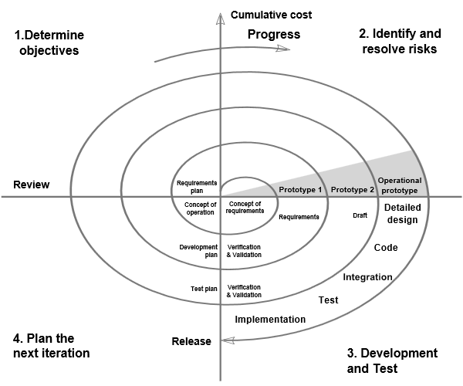
Spiral Process Model
Notes:
In 1988, Barry Boehm published a formal software system development "spiral model," which combines some key aspect of the waterfall model and rapid prototyping methodologies, in an effort to combine advantages of top-down and bottom-up concepts. It provided emphasis in a key area many felt had been neglected by other methodologies: deliberate iterative risk analysis, particularly suited to large-scale complex systems.
The basic principles are:^{[1]}
* Focus is on risk assessment and on minimizing project risk by breaking a project into smaller segments and providing more ease-of-change during the development process, as well as providing the opportunity to evaluate risks and weigh consideration of project continuation throughout the life cycle.
* "Each cycle involves a progression through the same sequence of steps, for each part of the product and for each of its levels of elaboration, from an overall concept-of-operation document down to the coding of each individual program."^{[9]}
* Each trip around the spiral traverses four basic quadrants:
(1) determine objectives, alternatives, and constraints of the iteration;
(2) evaluate alternatives; Identify and resolve risks;
(3) develop and verify deliverables from the iteration; and
(4) plan the next iteration.^{[10]}
Begin each cycle with an identification of stakeholders and their "win conditions", and end each cycle with review and commitment.^{[11]}

Slide 21
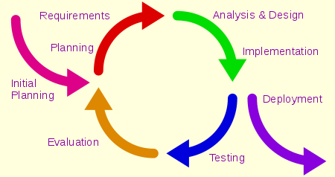
Iterative / Incremental Process Model
Notes:
any combination of both iterative design or iterative method and incremental build model for software development.
The combination is of long standing^{[1]} and has been widely suggested for large development efforts. For example, the 1985 DOD-STD-2167^{[2]} mentions (in section 4.1.2): "During software development, more than one iteration of the software development cycle may be in progress at the same time." and "This process may be described as an 'evolutionary acquisition' or 'incremental build' approach.“
The relationship between iterations and increments is determined by the overall software development methodology and software development process.
The exact number and nature of the particular incremental builds and what is iterated will be specific to each individual development effort.
Iterative and incremental development are essential parts of the Modified waterfall models, Rational Unified Process, Extreme Programming and generally the various agile software development frameworks.
It follows a similar process to the plan-do-check-act cycle of business process improvement.

Slide 22
Rational Unified Process Model
Unified Process –
popular iterative/incremental software process framework
Four phases:
Inception
Elaboration (milestone)
Construction (release)
Transition (final production release)
Rational Unified Process (RUP)
A version of Unified Process created by the Rational Software Corp., a division of IBM
an adaptable framework, intended to be tailored by the software project teams that select elements that are appropriate for their needs

Slide 23
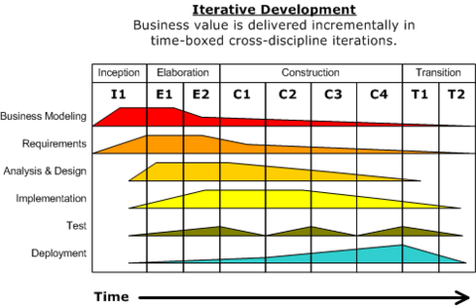
Rational Unified Process

Slide 24
Agile Models
Cross-functional teams
Requirements & solutions evolve
Adaptive planning, evolutionary development, early delivery, continuous improvement
Manifesto:
Individuals and Interactions more than processes and tools
Working Software more than comprehensive documentation
Customer Collaboration more than contract negotiation
Responding to Change more than following a plan
Examples:
Scrum
Kanban

Slide 25
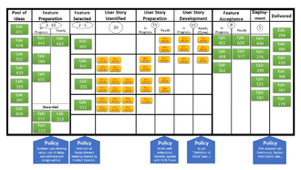
Agile Models
Scrum:
teams of 3-9 developers
work in 1 to 4 week cycles (sprints)
Check progress daily in 15 minute standup meetings
Deliver workable software after every sprint
Kanban
method for visualizing the flow of work
Goal is to balance demand with capacity, spot bottlenecks
Pull versus push

Slide 26
Process Vs. Product Discussion
Notes:
Allow at least 15 minutes. Student groups of 3 take a stand: Process is more important or Product is more important. Make sure there are enough groups for both sides. Have Process group call out their first key point. Product group then does two. Process group does two. Then Product group does one. Conclude noting that they are both important!

Slide 27
Process Quality: CMM
CMM = Capability Maturity Model
Watts Humphrey @ CMU’s SEI
Managing the Software Process (1989)
Levels:
Initial
Repeatable
Defined
Managed
Optimizing

Slide 28
CMM Characterization of Ratings
Initial
Ad hoc
Repeatable
A repeatable process is in place
Defined
Above + Standards are in place
Managed
Above + Metrics collection is in place
Optimizing
Above + Continuous improvement methods are in place

Slide 29
Team Formation
Team projects are weighted heavily
Three members per team, no more, no less; If the number of students is not divisible by 3, it may be necessary to have one or two teams of 2 students
Talk to your friends and form teams by next week
If you don’t take the initiative, you may be assigned to a team randomly at the instructor’s discretion
Notes:
Due before the next class

